Slide 1
Lecture #2: Getting our hands dirty: pandas and web scraping

Slide 2
ANNOUNCEMENTS
HW0 is due tomorrow at 11:59pm. It will be checked for ‘near completion’ and ‘reasonable effort’.
HW1 is posted and due Tuesday at 11:59pm.
HWs on Canvas. The rest of course content is on Git (and Ed).
Ed is where the discussions (HW questions) and quizzes reside.
Quizzes are under the ‘Lessons’ tab at the end of the lecture lesson.
If you can’t connect to Ed, try logging out of Canvas, then back into Canvas.

Slide 3
ANNOUNCEMENTS #2
OH Schedule (the rest of this week):
Wed: 3-4pm (Kevin) Thurs: 7-8:30am (Nabib), 6:30-8pm (Shivam) Fri: 2-3pm (Miroslav) Sat: 7:30-9pm (Sean) Sun: 10-11:30am (Sol)
*Note: times may change after this week and additional times may be added.

Slide 4
From last time.
So far, we’ve learned:
Lecture 1
Lecture 2
Future lectures
What is Data Science?
The Data Science Process
Data: types, formats, issues, etc.
Basic Summaries & Visualizations
How to quickly prepare data and scrape the web
How to model data

Slide 5
Background
The Data Science Process:
Ask an interesting question
Get the Data
This lecture
Explore the Data
Model the Data
Communicate/Visualize the Results

Slide 6
Lecture Outline
Exploratory Data Analysis (EDA):
Without Pandas
With Pandas
Data concerns
Collecting Data from the Web
Web Scraping with Beautiful Soup

Slide 7
Exploratory Data Analysis (EDA)
Why?
EDA encompasses the “explore data” part of the data science process
EDA is crucial but often overlooked:
If your data is bad, your results will be bad
Conversely, understanding your data well can help you create smart, appropriate models

Slide 8
Exploratory Data Analysis (EDA)
What?
Store data in data structure(s) that will be convenient for exploring/processing (Memory is fast. Storage is slow)
Clean/format the data so that:
Each row represents a single object/observation/entry
Each column represents an attribute/property/feature of that entry
Values are numeric whenever possible
Columns contain atomic properties that cannot be further decomposed*
* Unlike food waste, which can be composted. Please consider composting food scraps.

Slide 9
Exploratory Data Analysis (EDA)
What? (continued)
Explore global properties: use histograms, scatter plots, and aggregation functions to summarize the data
Explore group properties: group like-items together to compare subsets of the data (are the comparison results reasonable/expected?)
This process transforms your data into a format which is easier to work with, gives you a basic overview of the data's properties, and likely generates several questions for you to follow-up in subsequent analysis.

Slide 10
EDA: without Pandas
Say we have a small dataset of the top 50 most-streamed Spotify songs, globally, for 2019.
NOTE: The following music data are used purely for illustrative, educational purposes. The data, including song titles, may include explicit language. Harvard, including myself and the rest of the CS109 staff, does not endorse any of the entailed contents or the songs themselves, and we apologize if it is offensive to anyone in anyway.

Slide 11
EDA: without Pandas
top50.csv
Each row represents a distinct song. The columns are:
ID: a unique ID (i.e., 1-50)
TrackName: Name of the Track
ArtistName: Name of the Artist
Genre: the genre of the track
BeatsPerMinute: The tempo of the song.
Energy: The energy of a song - the higher the value, the more energetic.
Danceability: The higher the value, the easier it is to dance to this song.
Loudness: The higher the value, the louder the song.
Liveness: The higher the value, the more likely the song is a live recording.
Valence: The higher the value, the more positive mood for the song.
Length: The duration of the song (in seconds).
Acousticness: The higher the value, the more acoustic the song is.
Speechiness: The higher the value, the more spoken words the song contains.
Popularity: The higher the value, the more popular the song is.

Slide 12
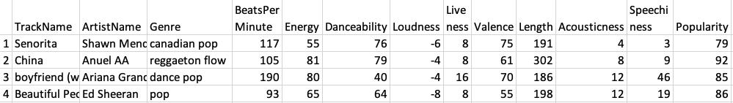
EDA: without Pandas
top50.csv
.
.
.
Q1: What are some ways we can store this file into data structure(s) using regular Python (not the Pandas library).

Slide 13
EDA: without Pandas
top50.csv
.
.
.
Possible Solution #1: A 2D array (i.e., matrix)
Weaknesses:
What are the row and column names? Need separate lists for them – clumsy.
Lists are O(N). We’d need 2 dictionaries just for column names
data = [][]
col_name -> index
index -> col_name

Slide 14
EDA: without Pandas
top50.csv
.
.
.
Possible Solution #2: A list of dictionaries
list
Item 1
=
{“Track.Name”: “Senorita”, “Artist.Name”: “Shawn Mendes”, “Genre”: “Canadian pop”, …}
Item 2
=
{“Track.Name”: “China”, “Artist.Name”: “Anuel AA”, “Genre”: “reggaetón flow”, … }
Item 3
=
{“Track.Name”: “Ariana Grande”, “Artist.Name”: “boyfriend”, “Genre”: “dance pop”, … }

Slide 15
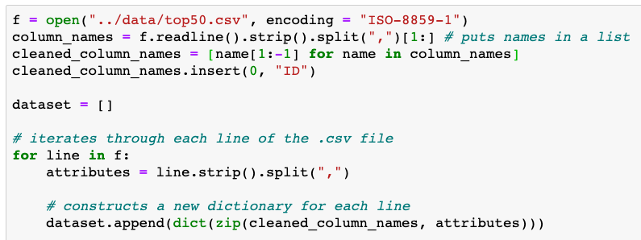
EDA: list of dictionaries
Possible Solution #2: A list of dictionaries
From Lecture2_Notebook.ipynb

Slide 16
EDA: list of dictionaries
Possible Solution #2: A list of dictionaries
Q2: Write code to print all songs (Artist and Track name) that are longer than 4 minutes (240 seconds):
From lecture2.ipynb

Slide 17
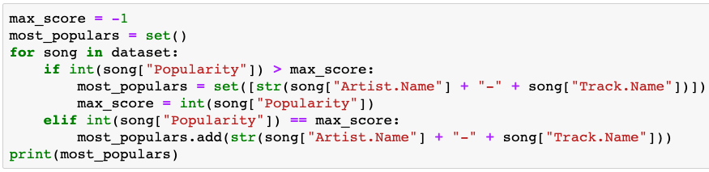
EDA: list of dictionaries
Possible Solution #2: A list of dictionaries
Q3: Write code to print the most popular song (artist and track) – if ties, show all ties.
From lecture2.ipynb

Slide 18
EDA: list of dictionaries
Possible Solution #2: A list of dictionaries
Q4: Write code to print the songs (and their attributes), if we sorted by their popularity (highest scoring ones first).

Slide 19
EDA: list of dictionaries
Possible Solution #2: A list of dictionaries
Q4: Write code to print the songs (and their attributes), if we sorted by their popularity (highest scoring ones first).
list
Item 1
=
{“Track.Name”: “Senorita”, “Artist.Name”: “Shawn Mendes”, “Genre”: “Canadian pop”, …}
Item 2
=
{“Track.Name”: “China”, “Artist.Name”: “Anuel AA”, “Genre”: “reggaetón flow”, … }
Item 3
=
{“Track.Name”: “Ariana Grande”, “Artist.Name”: “boyfriend”, “Genre”: “dance pop”, … }
Cumbersome to move dictionaries around in a list. Problematic even if we don’t move the dictionaries.

Slide 20
EDA: list of dictionaries
Possible Solution #2: A list of dictionaries
Q5: How could you check for null/empty entries? This is only 50 entries. Imagine if we had 500,000.
list
Item 1
=
{“Track.Name”: “Senorita”, “Artist.Name”: “Shawn Mendes”, “Genre”: “Canadian pop”, …}
Item 2
=
{“Track.Name”: “China”, “Artist.Name”: “Anuel AA”, “Genre”: “reggaetón flow”, … }
Item 3
=
{“Track.Name”: “Ariana Grande”, “Artist.Name”: “boyfriend”, “Genre”: “dance pop”, … }

Slide 21
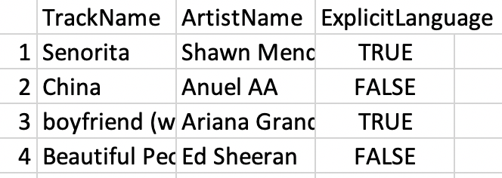
EDA: list of dictionaries
Possible Solution #2: A list of dictionaries
Q6: Imagine we had another table* below (i.e., .csv file). How could we combine its data with our already-existing dataset?
spotify_aux.csv
* 3rd column is made-up (randomly created values). Pretend they’re accurate.

Slide 22

EDA: with Pandas!
Kung Fu Panda is property of DreamWorks and Paramount Pictures

Slide 23
Lecture Outline
Exploratory Data Analysis (EDA):
Without Pandas
With Pandas
Data concerns
Reading Data from the Web
Web Scraping with Beautiful Soup

Slide 24
EDA: with Pandas
What / Why?
Pandas is an open-source Python library (anyone can contribute)
Allows for high-performance, easy-to-use data structures and data analysis
Unlike NumPy library which provides multi-dimensional arrays, Pandas provides 2D table object called DataFrame (akin to a spreadsheet with column names and row labels).
Used by a lot of people

Slide 25
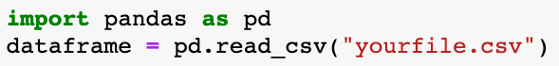
EDA: with Pandas
How
import pandas library (convenient to rename it)
Use read_csv() function

Slide 26
EDA: with Pandas
Common Panda functions (we’ve seen most of these already)
High-level viewing:
head() – first N observations
tail() – last N observations
columns() – names of the columns
describe() – statistics of the quantitative data
dtypes() – the data types of the columns

Slide 27
EDA: with Pandas
Common Panda functions
Accessing/processing:
df[“column_name”]
Df.column_name
.max(), .min(), .idxmax(), .idxmin()
<dataframe> <conditional statement>
.loc[] – label-based accessing
.iloc[] – index-based accessing
.sort_values()
.isnull(), .notnull()

Slide 28
EDA: with Pandas
Common Panda functions
Grouping/Splitting/Aggregating:
groupby(), .get_groups()
.merge()
.concat()
.aggegate()
.append()

Slide 29
EDA: with Pandas
Now, let’s open the Lecture2_Notebook.ipynb notebook for some real-time practice.

Slide 30
Lecture Outline
Exploratory Data Analysis (EDA):
Without Pandas
With Pandas
Data concerns
Collecting Data from the Web
Web Scraping with Beautiful Soup

Slide 31
Data Concerns
When determining if a dataset is sound to use, it can be useful to think about these four questions:
Did it come from a trustworthy, authoritative source?
Is the data a complete sample?
Does the data seem correct?
(optional) Is the data stored efficiently or does it have redundancies?

Slide 32
Data Concerns: the format
Often times, there may not exist a single dataset that contains all of the information we are interested in.
May need to merge existing datasets
Important to do so in a sound and efficient format

Slide 33
Data Concerns: the format
For example, say we have two datasets:
Dataset 1
Dataset 2
Top 200 most-frequent streams per day (for June 2020)
Top 50 most streamed in 2019
SpotifySongID, # of Streams, Date
SpotifySongID, Artist, Track, [10 acoustic features]
2789179, 42003, 06-01
2789179, Billie Eilish, bad guy, 3.2, 5.9, …
.
.
200
.
.
50
3819390, 89103, 06-01
3901829, Outkast, Elevators, 9.3, 5,1, …
4492014, 52923, 06-02
.
50 x 13
200
.
8593013, 189145, 06-02
6,000 x 3

Slide 34
Data Concerns: the format
Dataset 2
For example, say we have two datasets:
Top 50 most streamed in 2019, so far
Dataset 1
Top 200 most-frequent streams per day (for June 2019)
SpotifySongID, Artist, Track, [10 acoustic features]
2789179, Billie Eilish, bad guy, 3.2, 5.9, …
.
.
SpotifySongID, # of Streams, Date
50
3901829, Outkast, Elevators, 9.3, 5,1, …
2789179, 42003, 06-01
.
200
.
50 x 13
3819390, 89103, 06-01
We are interested in determining if songs with high danceability are more popular during the weekends of June than weekdays in June. What should our merged table look like? Concerns?
4492014, 52923, 06-02
.
200
.
8593013, 189145, 06-02
6,000 x 3

Slide 35
Data Concerns: the format
This is wasteful, as it has 10 acoustic features, artist, and track repeated many times for each unique song.
Datasets Merged (poorly)
SpotifySongID, # of Streams, Date,
Artist, Track, [10 acoustic features]
2789179, 42003, 06-01
Billie Eilish, bad guy, 3.2, 5.9, …
.
200
.
3819390, 89103, 06-01
Outkast, Elevators, 9.3, 5,1, …
4492014, 52923, 06-02
.
200
.
8593013, 189145, 06-02
6,000 x 15 ➔ 90,000 cells

Slide 36
Data Concerns: the format
Some rows may have null values for # of Streams (if the song wasn’t popular in June)
Datasets Merged (better)
SpotifySongID, Artist, Track, [10 acoustic features], 06-01 Streams, 06-02 Streams
2789179, Billie Eilish, bad guy, 3.2, 5.9, …, 42003, 42831, 43919
.
.
50
3901829, Outkast, Elevators, 9.3, 5,1, … 29109, 27193, 25982
50 x 70 ➔ 3,500 cells

Slide 37
Data Concerns: the format
Is the data correctly constructed (or are there any wrong values)?
Is there redundant data in our merged table?
Are there any missing values?

Slide 38
Lecture Outline
Exploratory Data Analysis (EDA):
Without Pandas
With Pandas
Data concerns
Collecting Data from the Web
Web Scraping with Beautiful Soup

Slide 39
Sources of data
Data can come from several sources:
You curate it
Someone else provides it, all pre-packaged for you
Kaggle: https://www.kaggle.com/datasets
Johns Hopkins (COVID): https://github.com/CSSEGISandData/COVID-19
Someone else provides an API (Application programming interface)
Twitter: https://developer.twitter.com/en/docs
Someone else has available content, and you try to take it (ex: web scraping).
This part of the lecture notes addresses this approach.

Slide 40
What is a website?

Slide 42
Web servers
Website servers
A server is a long-running process (also called a daemon) which listens on pre-specified port(s).
It responds to requests (from a client), which is sent using a protocol called HTTP (HTTPS is secure).
Our browser (like Chrome) sends these requests and downloads the content, then displays it.
The server communicates back to the client the following codes depending on how the connection went:
2– request was successful, 4– client error, often `page not found`; 5– server error (often that your request was incorrectly formed)
https://en.wikipedia.org/wiki/List_of_HTTP_status_codes

Slide 43
HTML: the language of the web
Most websites are really just snippets of Hypertext Markup Language (HTML) code.
As per Wiki: “Hypertext Markup Language (HTML) is the standard markup language for documents designed to be displayed in a web browser. It can be assisted by technologies such as Cascading Style Sheets (CSS) and scripting languages such as JavaScript and VBScript.”
We do not need to know much about HTML to scrape the web, but getting a little glimpse into the format is helpful.
Google’s Chrome can help with this task (in the menu: View -> Developer -> Developer Tools).

Slide 45
Web scraping
Scraping the web is then a process of using programs to download or otherwise get data from these online servers.
Typically, processing (HTML) code that is being sent from server to client.
Often much faster than manually copying data!
Part of the process is transferring the relevant data into a form that is compatible with your code.
Always remember: legal and ethical issues should be considered (see Lecture 1).

Slide 46
Web scraping in Python
Requests (Python library): gets a webpage for you
Requests.get(url)
The BeautifulSoup library helps to make parsing webpages (.html content) much easier!
Use BeautifulSoup to quickly find, save, and organize all the text, or all the links, or all the tables, etc. on a webpage
Documentation: http://crummy.com/software/BeautifulSoup

Slide 47
Web scraping
Why scrape the web?
Vast source of information; often useful to combine with other data sets (or across web-based sources)
Companies have not provided APIs or otherwise publicly available data
It can automate tasks (rather than using the oldf copy-and-paste many, many times).
Keep up with real-time updates on websites (think election night data).
Because its fun, and allows us to answer interesting questions we would otherwise be unable to answer!

Slide 48
Web scraping
A few words of advice while scraping:
Be careful and polite
Give credit where credit is due (like proper citations)
Be aware of media law!
Don’t be evil (no spamming, overloading sites, etc.).

Slide 49
Robots
Be aware of the Robots.txt (like a readme) page on many websites:
Specified by website owners
Gives instructions to web robots (aka web crawlers, like our scripts).
Is located at the top-level of the web server’s directory
Ex: https://www.google.com/robots.txt

Slide 50
A little HTML
Contains many angle brackets for ‘tags’ (define structure of the content)
Often in pairs, ex: <p>Hello</p>
Lines are often separated by unpaired breaks: <br>
Tables are typically defined by <table>, with <tr> for table rows, <th> for table headers and <td> table cells/data.

Slide 51
HTML examples
A simple page: A simple table:

Slide 52
Web scraping with Beautiful Soup
We highly suggest using BeautifulSoup (within the library bs4) to do html scraping and handling for you.
it will quickly organize and parse dirty html for you.
it is sometimes easier using regular expression instead, see Friday’s lab).
Basic usage:

Slide 53
BeautifulSoup structure
HTML is structured like a tree when read in via BeautifulSoup:

Slide 54
Some thinking questions
Question: how can we get a list of all image URLs?
Question: how can we navigate through subsequent pages (i.e., crawler) recursively?
Question: could we crawl the entire web?
Note: we will go through much more details of scraping in Friday’s lab.

